Slide 1
KUKA Sim Pro
Ekman Deol
Varinder Malik
Shubham Sharma
Deval Patel

Slide 2
Introduction
Basics of Dimensions and Drawing
Creating an Annotation
Exporting & Importing Drawing and Drawing Template
Printing a Drawing
Programming and Manipulation of Robot

Slide 3
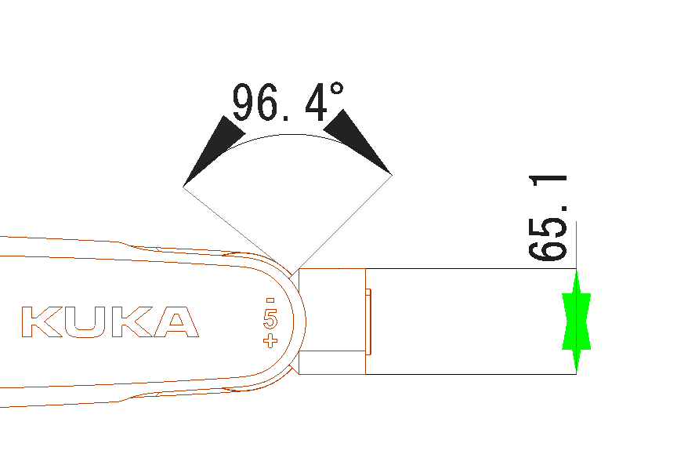
Creating a dimension
Dimension helps in measurement of particular distance or angle,
and mention it on the drawing.
On the Drawing tab, in the Dimension group, do one of the following:
To create a dimension for measuring the angle between two points,
click Angular.
To create a dimension for measuring the distance between two points,
click Linear.
To define the dimension, click to define two points.

Slide 4
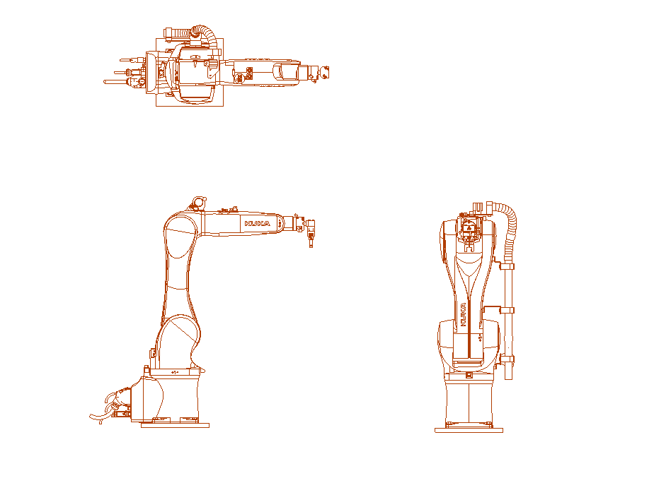
Creating a Drawing
Drawing can be illustrated as 2D standard views of 3D object.
On the Drawing tab, in the Create View group, do one of the following:
To create a top view drawing, click Top.
To create a bottom view drawing, click Bottom.
To create a left view drawing, click Left.
To create a right view drawing, click Right.
To create a front view drawing, click Front.
To create a back view drawing, click Back.
If you need to manually create a drawing, click New Drawing.
In the Properties panel, do any of the following:
Define the Scale of the drawing.

Slide 5
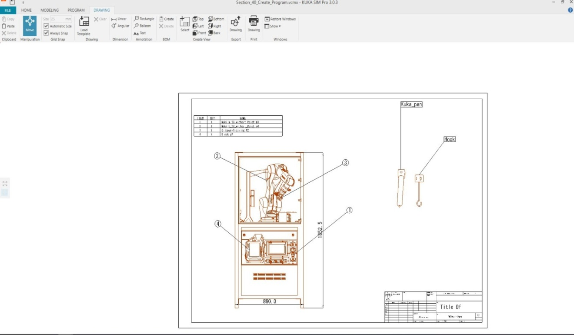
Creating an Annotation
An annotation allows you to create a visual callout or markup for explaining one or more elements of a drawing.
Select one of the following in Annotation group:
Rectangle-Shaped Annotation
Circle-Shaped Annotation
Define properties from Annotation properties window
Line color, thickness
Edge, Surface

Slide 6
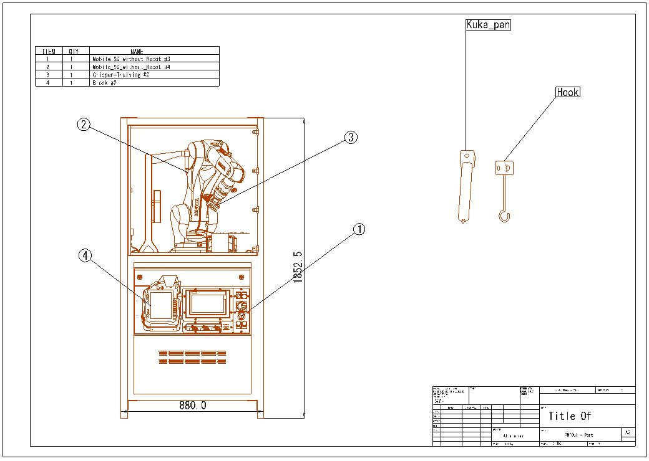
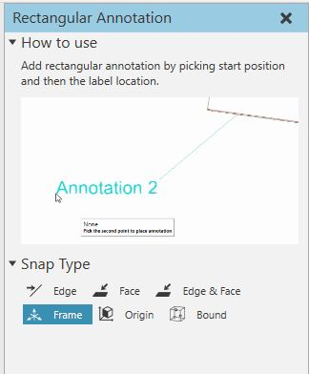

Slide 7
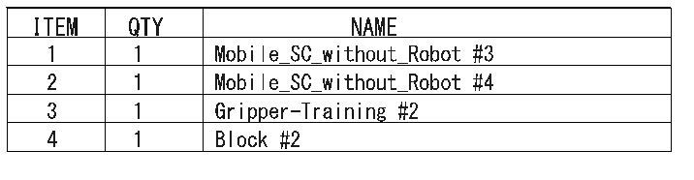
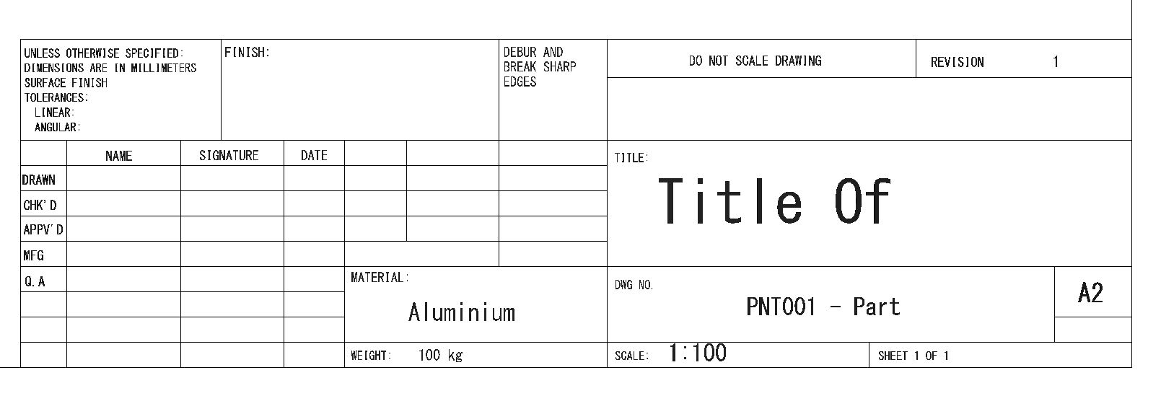
Bill of Material (BOM) & Title Box
In the BOM tab, click on create option for generating
Bill of Material table for circular annotations.

Slide 8
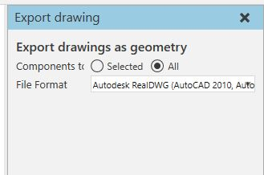
Exporting Drawing
Export the full Drawing OR Select multiple components by pressing
CTRL and clicking one by one on drawing.
go to Export drawing by clicking Export tab
check in Selected components
Select format PDF, AutoCAD, Autodesk etc.

Slide 9
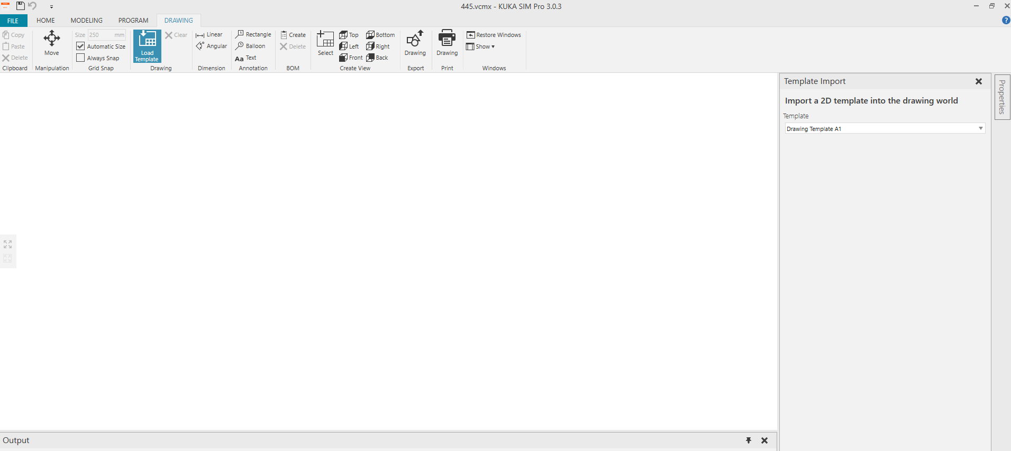
Finding & importing Drawing Template
A drawing template allows you to scale drawings,
generate a bill of materials (BOM), and export a print-ready document
or CAD file for your drawings.
In the Drawing Bar, Go to Drawing group and Select Load Template
Select Sheet size(A0 to A4) and import
Define title and Scale

Slide 10
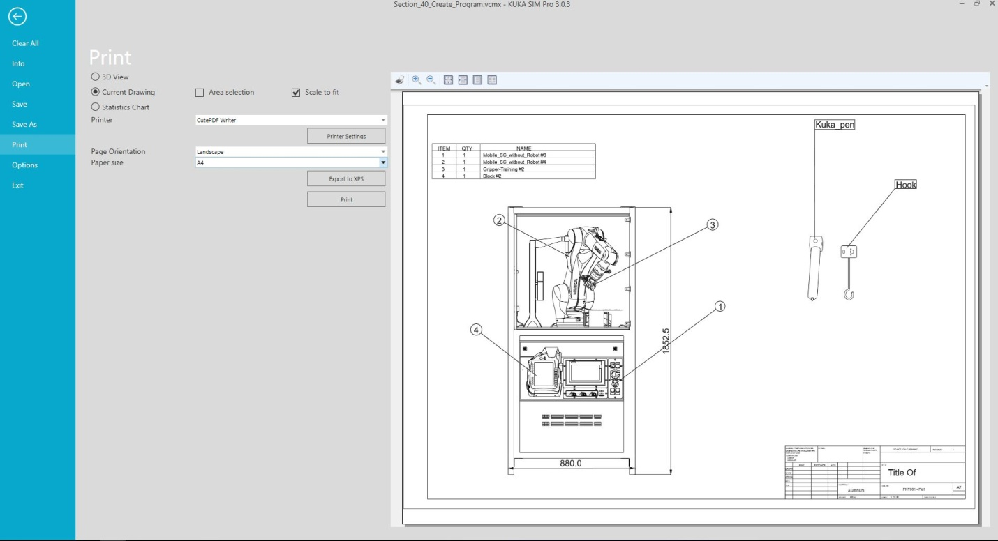
Printing Drawing
A drawing can be exported to produce a print-ready document.
Generally, a template is used to print one or more drawings as a sheet.
Select Drawing in the Print group on Drawing Tab
In Print preview, Select Page Orientation, Paper Size and Area Selection.

Slide 11

Programming
SNAP function – Move selected object using target location
1-point, 2-point (Midpoint), etc.
Set orientation (rotation) and set position (position)
ALIGN Function – Line up two points
1-point, 2-point
MOVE – To move in 3D world
Orient in X Y Z direction (3D world)
JOG – Manipulate robot
manipulate in any direction
SELECT
Rectangular, random, etc.

Slide 12
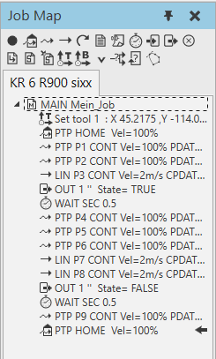
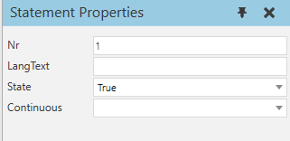
Pick and Place a cube
1 2 3 4 5 6 7 8
1 - Add PTP home command
2 – PTP Command
3 – Line Command
4 – Add CIRC command
5 – Wait command
6 – Add wait for In Command
7 – Add wait for Out Command
8 – Add Halt command
For Gripping and Releasing

Slide 13
Thank you
Questions ???

